Slide 1
Into To Android
Views and Layouts

Slide 2
Two Types Of Building Blocks
Views
Layouts/ViewGroups
Text
Button
Image
Checkbox
etc
Define the Placement of Views on the screen
They are Containers
Are Invisible

Slide 3
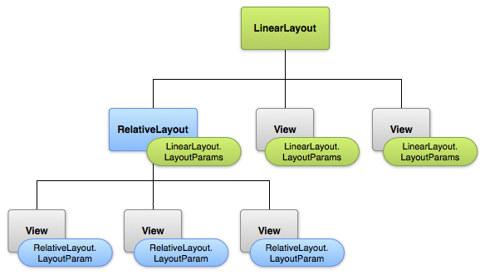
Layout Hierarchy
Views and Layouts are organized in a tree
Layouts contain multiple views and Layouts
Layouts and Views have Properties that define there display Aspects

Slide 4
Create Layouts
Layouts defined in XML files in /res/layout project folder
Graphical Editor to help quickly prototype

Slide 5
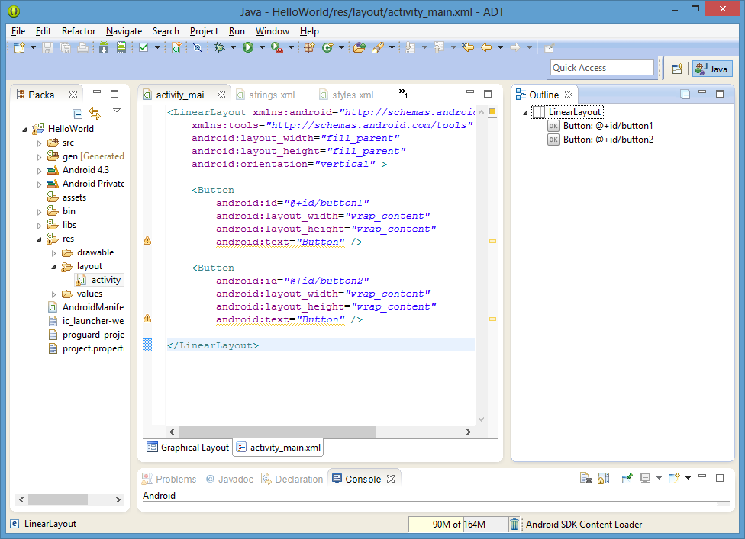

Slide 6
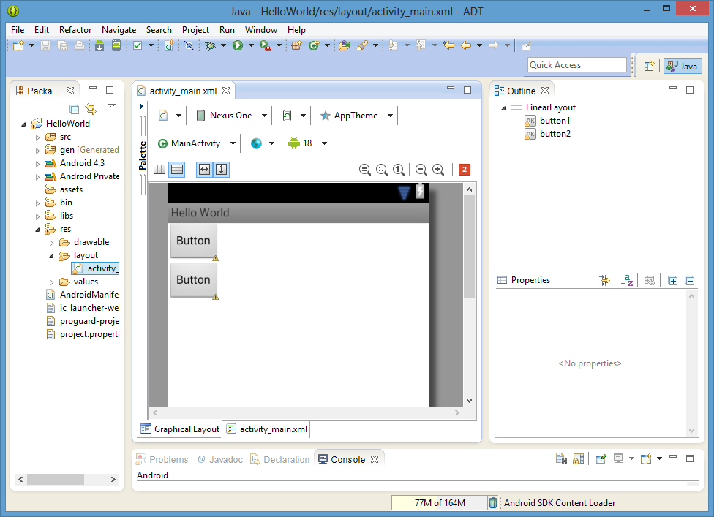

Slide 7

Linear Layout
Like a bookcase!!
A layout that organizes its children into a single horizontal or vertical row.
<LinearLayout
…android:orientation="vertical|horizontal”…
>

Slide 8

Relative Layout
displays child views in relative positions. The position of each view can be specified as relative to sibling elements (such as to the left-of or below another view) or in positions relative to the parent
<Relativelayout
>

Slide 9

Button
Clickable action
Can have Icon and/or text
<Button
android:id=“@+id/my_button”
android:layout_width=“wrap_content”
android:layout_height=“wrap_content”
android:text=“click me” />

Slide 10
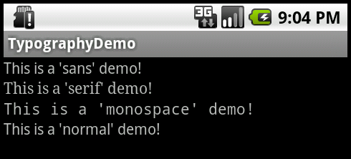
TextView
Displays text
Not editable
Can have different styles and fonts
<TextView
android:id="@+id/my_textview"
android:layout_width="wrap_content"
android:layout_height="wrap_content"
android:text="Hello World!"/>

Slide 11
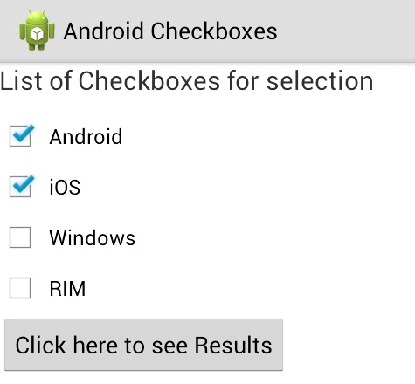

CheckBox
Select multiple items
<CheckBox
android:id="@+id/my_textview"
android:layout_width="wrap_content"
android:layout_height="wrap_content"
android:text=“Do you like pizza?"/>

Slide 12
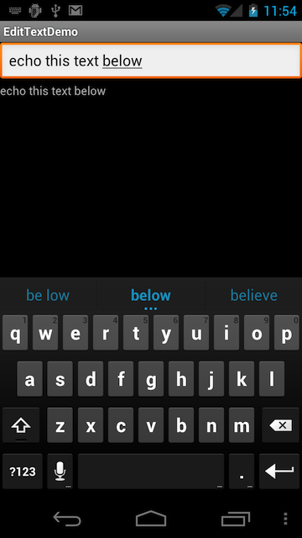
TextEdit
Input data
<TextEdit
android:id="@+id/my_textview"
android:layout_width="wrap_content"
android:layout_height="wrap_content"
/>

Slide 13

ImageView
<ImageView
android:id="@+id/my_textview"
android:layout_width="wrap_content"
android:layout_height="wrap_content"
android:src="@drawable/my_pix"
/>

Slide 14
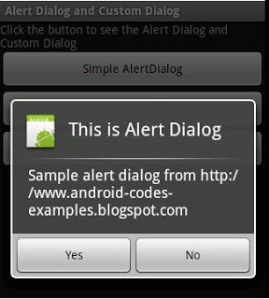
Dialog
Demands user attention
Usually dismissed by selecting on of many options
Popup window to Notify user
Can Optionally show buttons (yes/No)
Demands User attention

Slide 15
View Attributes

Slide 16
Id
android:id=“@+id/my_button”
The plus-symbol (+) indicates a new symbol to be added to the resource file
Button myButton = (Button) findViewById(R.id.my_button);
Uniquely Identify views so they can be easily referred to in Java code.

Slide 17
Height And Width
android:height|width=“wrap_content”
Only as big as needed
android:height|width=“fill_parent”
→fill the entire available area within the parent layout

Slide 18
Background
Colors: html values
android:background=“#336699”
Image background
android:background=“@drawable/my_pix”

